Slide 1

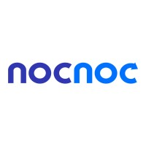
Business Case
Enhancing Customer Experience Through Delivery Efficiency

Slide 2

Introducción
In the realm of e-commerce, timely product delivery is paramount for both customer satisfaction and business success. In this presentation, I will analyze the logistical performance of nocnoc, a leading player in the e-commerce industry in Latin America.
The goal is to scrutinize various facets of nocnoc's delivery process, ranging from average delivery time to geographical patterns of delays, and propose initiatives aimed at enhancing efficiency and customer experience.

Slide 3
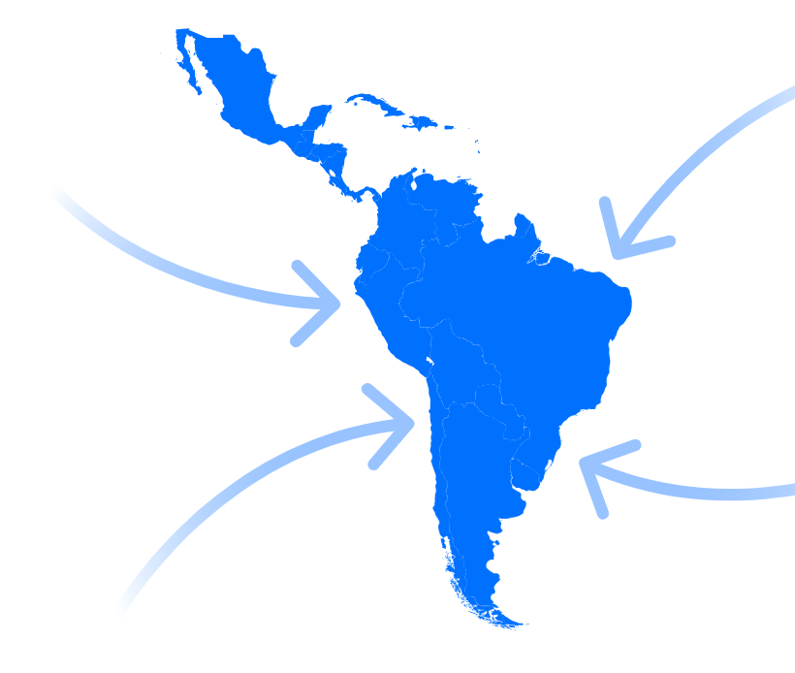
ETL con Python
Tools Used:
Python (pandas, numpy, matplotlib).
Data Cleaning Process:
DataFrame Creation.
Data Integrity Verification:
Removal of duplicates.
Handling of null and missing data.
Null Data:
Orders in process or canceled: Not modified.
Missing delivery dates (shipped products):
Imputation using the mean of available dates.
Dataset Integration:
Joining datasets using 'order_id'.
Results:
Complete dataset ready for analysis.
Assurance of data quality and integrity.

Slide 4

Análisis de los datos
Methodological Approach:
Addressing questions one by one.
Utilizing data queries, statistical calculations, and visualizations.
Supported by Evidence:
Each answer was supported by solid data.
Clear explanations provided for easy understanding.
Interpretation and Conclusions:
Results interpreted and significant conclusions drawn.
Clear and concise presentation of results and conclusions.
Relevant recommendations provided when applicable.
Accessibility of the Report:
Final report accessible and understandable for the target audience.
Added Value:
Effective process for addressing business case questions.
Provision of valuable insights for data-driven decisions.

Slide 5
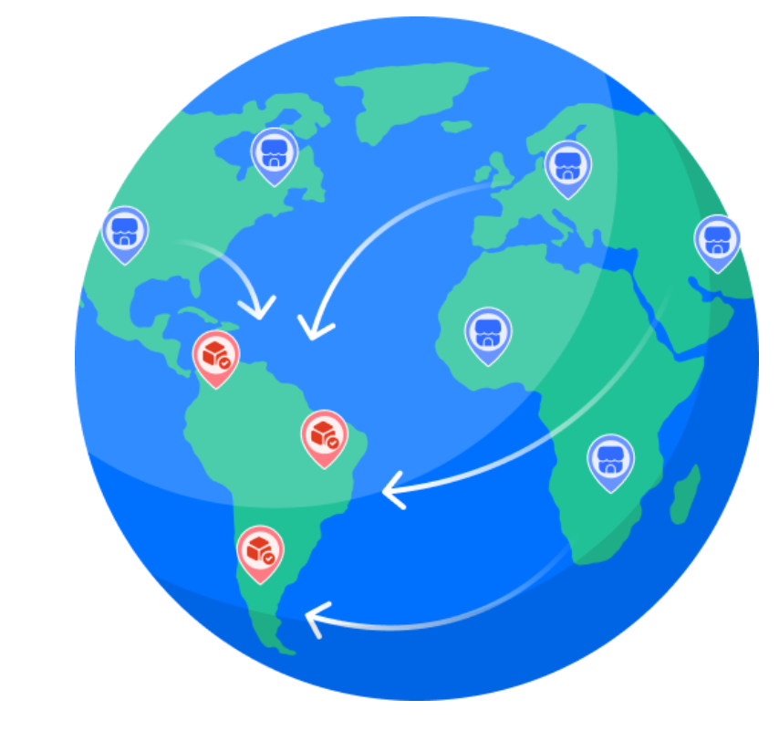
Conclusión
Strengths in Delivery Performance:
Identification of a high percentage of on-time deliveries (91.89%), highlighting reliability and efficiency across most regions.
Areas for Improvement:
Identification of significant delays in specific states such as Maranhão and Alagoas, suggesting the need to improve logistical infrastructure and address socioeconomic and environmental factors.
Strategic Recommendations:
Implementation of advanced inventory management systems and emerging technology to optimize operations.
Establishment of additional strategic warehouses to reduce transit times and enhance the customer experience.

